Slide 1

13. Optimal Estimation: Operational Considerations
Dr. David R. Thompson
Jet Propulsion Laboratory, Imaging Spectroscopy Group

Slide 2
Goals for this module
Perform superpixel segmentation of imaging spectroscopy data
Apply KD-trees for efficient spatial inference
Extrapolate OE Solutions to invert a radiance cube of 160000 spectra

Slide 3
One approach for speeding OE retrievals
Key insight: there is a lot of redundancy in the atmospheric information of an image cube
General strategy
Search the image for a handful of geographically and compositionally representative locations
Find full, exact solutions for this representative subset
Use this subset to infer the exact result of the remainder
Here we explore using superpixel segmentation for #1, and the empirical line solution for #3.
Notes:
We measured 6 sites at Ivanpah, JPL, and Caltech.

Slide 4
Superpixel segmentation
[Thompson et al., Remote Sens. Environment 2020]
Create spatially-contiguous clusters of similar radiances. Use cluster means as our reference set.

Slide 5
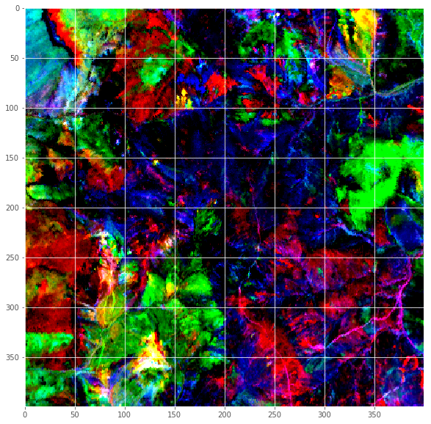
PCA representations
RGB: first three principal components
SLIC was developed for monochrome and RGB images, and implimentations typically use Euclidean distances.
We use the top 5 principal components as an orthogonal basis.

Slide 6
Finding nearest neighbors – 1D
How to efficiently find nearest neighbors?
X = [10 9 14 30 100 5 32 -4 3 72
4
Sequential search: linear time ☹

Slide 7
Finding nearest neighbors – 1D
How to efficiently find nearest neighbors?
X = [10 9 14 30 100 5 32 -4 3 72]
X’ = [-4 3 5 9 10 14 30 32 72 100]
4
Sequential search: linear time ☹
SORT

Slide 8
Finding nearest neighbors – 1D
How to efficiently find nearest neighbors?
X = [10 9 14 30 100 5 32 -4 3 72]
X’ = [-4 3 5 9 10 14 30 32 72 100]
4
Sequential search: linear time ☹
SORT
4
Binary search: logarithmic time ☺

Slide 9
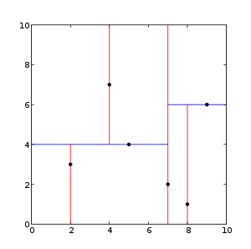
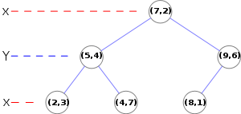
2 to 8 dimensions: K-D Trees
Each node splits the space with a hyperplane
Which one? Cycle through axis-aligned hyperplanes
Typical search is O(log n)
c
b
b
c
Level a
a
Level b
c
y
Level c
x
Source: Wikipedia

Slide 10
> 8 dimensions: Use approximate nearest neighbors
Above 8-10 dimensions, even partitioning structures are little better than brute force.
Approximate nearest neighbor methods can improve computation by orders of magnitude.
Source: Wikipedia

Slide 11
Extrapolating the representative spectra
Inference could involved cached atmospheric optical coefficients, or spatial statistics to infer the smooth atmospheric field.
Here, we use the paired radiance / reflectance spectra in an Empirical Line approach:
Find the local k nearest neighbor reference spectra
Distance can be geographic, spatial, spectral, etc.
For each wavelength:
Regress the reference radiances onto their reflectances using standard linear least squares
Use this solution to predict the corresponding reflectance in the query spectrum
Notes:
We measured 6 sites at Ivanpah, JPL, and Caltech.

Slide 12
Example: 15 nearest neighbors
Nearest neighbor solutions
Reflectance prediction for the query radiance
Note: Many points share the same set of nearest neighbors, so caching the coefficients in a hash table enables more speed improvements
Notes:
We measured 6 sites at Ivanpah, JPL, and Caltech.

